Slide 1
AM263X block diagram:

Slide 2
Examples
And Demos
Tools
Examples
Demos
SDK Tools (Flashing, Boot, …)
Protocol stacks
And Middleware
TI Resource Explorer (TIREX)
Mbed TLS
LwIP (TCP/UDP)
FreeRTOS + FAT
SysConfig
Drivers and
HAL
Board Peripheral Drivers
SOC Peripheral Drivers
TI CLANG Compiler
OS
Kernel
Code Composer Studio (CCS)
Smart Placement
FreeRTOS POSIX
Driver Porting Layer (DPL)
FreeRTOS Kernel
No RTOS
ARM R5F, ARM M4F + SOC peripherals + EVM peripherals
X86 Host (Windows / Linux)

Slide 3
AM64X/AM243X block diagram:

Slide 4
Examples
And Demos
Tools
Examples
Demos
SDK Tools (Flashing, Boot, …)
Protocol stacks
And Middleware
TI Resource Explorer (TIREX)
TinyUSB
FreeRTOS + FAT
LwIP (TCP/UDP)
Mbed TLS
SysConfig
Drivers and
HAL
Board Peripheral Drivers
SOC Peripheral Drivers
TI CLANG Compiler
OS
Kernel
Code Composer Studio (CCS)
FreeRTOS POSIX
Driver Porting Layer (DPL)
FreeRTOS Kernel
No RTOS
ARM A53, ARM R5F, ARM M4F + SOC peripherals + EVM peripherals
X86 Host (Windows / Linux)

Slide 5
Examples
And Demos
Tools
Examples
Demos
SDK Tools (Flashing, Boot, …)
Protocol stacks
And Middleware
TI Resource Explorer (TIREX)
TinyUSB
FreeRTOS + FAT
LwIP (TCP/UDP)
Mbed TLS
SysConfig
Drivers and
HAL
Board Peripheral Drivers
SOC Peripheral Drivers
TI CLANG Compiler
OS
Kernel
Code Composer Studio (CCS)
Smart Placement
FreeRTOS POSIX
Driver Porting Layer (DPL)
FreeRTOS Kernel
No RTOS
ARM R5F, ARM M4F + SOC peripherals + EVM peripherals
X86 Host (Windows / Linux)

Slide 6
Examples
And Demos
Tools
Examples
MMWave Demos
SDK Tools (Flashing, Boot, …)
Protocol stacks
And Middleware
LwIP (TCP/UDP)
MMWave Framework
TI Resource Explorer (TIREX)
SysConfig
Drivers and
HAL
Board Peripheral Drivers
SOC Peripheral Drivers
TI C6000 Compiler
TI CLANG Compiler
OS
Kernel
FreeRTOS POSIX
Driver Porting Layer (DPL)
Code Composer Studio (CCS)
FreeRTOS Kernel
No RTOS
ARM R5F, TI C66x + SOC peripherals + EVM peripherals
X86 Host (Windows / Linux)

Slide 7
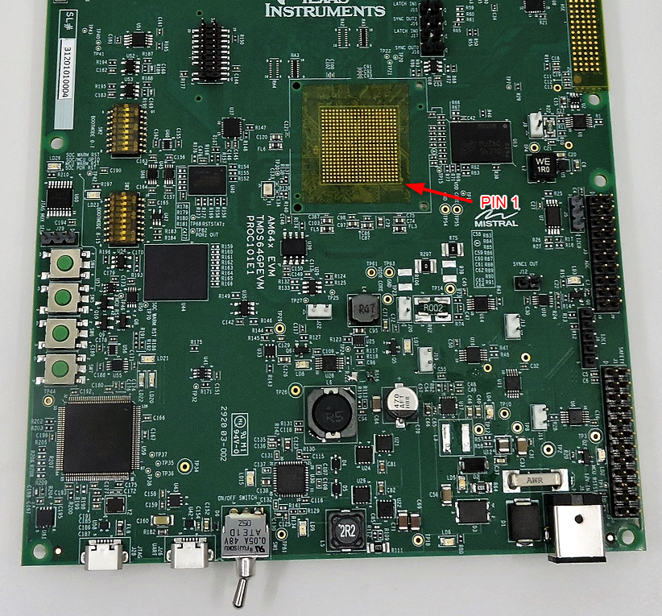
SD card
BOOT MODE 0-15
JTAG XDS110
UART to USB
Power switch
Power supply (12V, 5A)
7

Slide 8
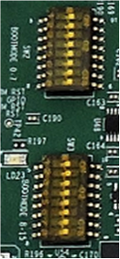
BOOTMODE
0:7 (SW2)
BOOTMODE
8:15 (SW3)
BOOTMODE
0:7 (SW2)
BOOTMODE
8:15 (SW3)
NO BOOT MODE
OSPI BOOT MODE
BOOTMODE
0:7 (SW2)
BOOTMODE
8:15 (SW3)
BOOTMODE
0:7 (SW2)
BOOTMODE
8:15 (SW3)
UART BOOT MODE
SD BOOT MODE
8

Slide 9
BOOTMODE
0:7 (SW2)
BOOTMODE
8:15 (SW3)
BOOTMODE
0:7 (SW2)
BOOTMODE
8:15 (SW3)
DEV BOOT MODE
EMMC BOOT MODE
BOOTMODE
0:7 (SW2)
BOOTMODE
8:15 (SW3)
PCIE BOOT MODE
9

Slide 10
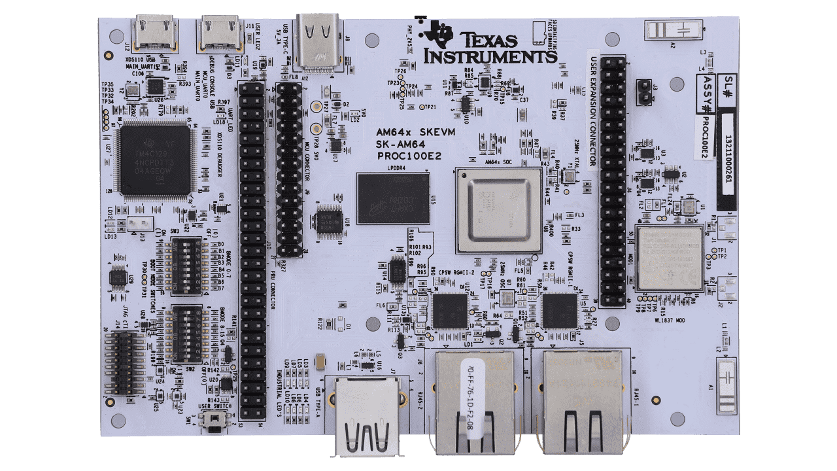
UART to USB
Power supply (5V, 3A)
JTAG XDS110
BOOT MODE SW3 (0-7)
BOOT MODE SW2 (8-15)
10

Slide 11
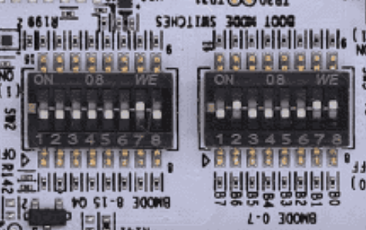
c
c
c
c
BOOTMODE
8:15 (SW2)
BOOTMODE
0:7 (SW3)
BOOTMODE
8:15 (SW2)
BOOTMODE
0:7 (SW3)
UART BOOT MODE
OSPI BOOT MODE
11

Slide 12
c
c
c
c
BOOTMODE
8:15 (SW2)
BOOTMODE
0:7 (SW3)
BOOTMODE
8:15 (SW2)
BOOTMODE
0:7 (SW3)
SD BOOT MODE
NO BOOT MODE
12

Slide 13
c
c
BOOTMODE
8:15 (SW2)
BOOTMODE
0:7 (SW3)
EMMC BOOT MODE
13

Slide 14
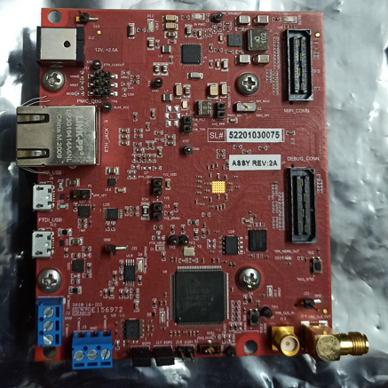
Power Supply
(12V 5A)
Jtag XDS 110
Uart to USB
Reset Button
Boot Mode
Switches

Slide 15
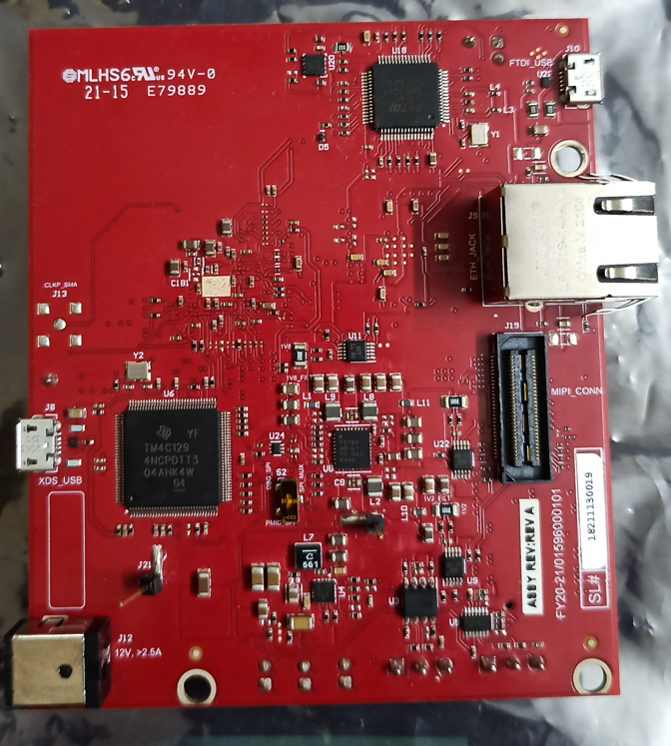
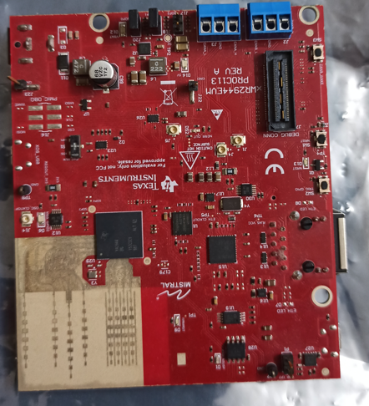
Uart to USB
Boot Mode
Switches
Reset Button
Jtag XDS 110
Power Supply
(12V 5A)
15

Slide 16
Application
Layer 7 - Application
EtherCAT Slave Stack
ARM
Processor
FW HAL for EtherCAT Slave
Customer
Third Party
TI
PRUICSS Driver
PRU Firmware
PRUICSS
PRUICSS with 2x MII
Layer 2 - Data Link
Layer 1 - Physical
Ethernet PHY
Ethernet PHY

Slide 17
RPRC Format
Offset
RPRC Header
Section 1 Header
Section 1 Content
Section 2 Header
Section 2 Content
Section 3 Header
Section 3 Content
RPRC Magic Word
Entry Point
Reserved
Section Count
Version
0x00000000
0x00000004
(20 Bytes)
0x00000008
0x0000000C
0x00000010
Section Run Address
Reserved
Section Size
Reserved
Reserved
0x00000000
(20 Bytes)
0x00000004
0x00000008
0x0000000C
0x00000010

Slide 18
RPRC Format
Offset
RPRC Header
Section 1 Header
Section 1 Content
Section 2 Header
Section 2 Content
Section 3 Header
Section 3 Content
RPRC Magic Word
Entry Point
Reserved
Section Count
Version
0x00000000
0x00000004
(20 Bytes)
0x00000008
0x0000000C
0x00000010
Section Run Address
Reserved
Section Size
Reserved
Reserved
0x00000000
(20 Bytes)
0x00000004
0x00000008
0x0000000C
0x00000010

Slide 19
XIP gen
RPRC Header (entry point = 0x0)
Section 1 Header (addr = 0x0, size = 0x80)
Section 1 Content
Section 2 Header (addr = 0x70080000, size = 8KB)
Section 2 Content
Section 3 Header (addr = 0x60100000, size = 64KB)
Section 3 Content
Section 4 Header (addr = 0x60110000, size = 16KB)
Section 4 Content
RPRC Header (entry point = 0x0)
Section 1 Header (addr = 0x0, size = 0x80)
Section 1 Content
Section 2 Header (addr = 0x70080000, size = 8KB)
Section 2 Content
Non-XIP RPRC file
xipGen
XIP RPRC file
RPRC Header (entry point = NOT USED)
Section 1 Header (addr = 0x60100000, size = 80 KB)
Section 1 Content (merged content of section 3 + section 4)
XIP sections
Merged
XIP section
19

Slide 20
Post build steps
v
.c
.obj
compiler
.rprc
…
.out
.rprc
xipGen
.c
.obj
compiler
out2rpc
.rprc_xip
…
linker
multiCoreGen
.appimage
.lib
CPU1
…
.appimage_xip
v
multiCoreGen
.c
.obj
compiler
.rprc
…
.out
.rprc
xipGen
.c
.obj
compiler
out2rpc
.rprc_xip
…
linker
.lib
CPUn
20

Slide 21
Post build steps
v
.c
.obj
compiler
…
.out
.rprc
.c
.obj
compiler
out2rpc
…
linker
.lib
.appimage
CPU1
multiCoreGen
…
v
.c
.obj
compiler
…
.out
.rprc
.c
.obj
compiler
out2rpc
…
linker
.lib
CPUn
21

Slide 22
Multi-core Image
Offset
Multi-Core Header
Core 1 Meta Header
Core 2 Meta Header
….
Header End
Core 1 RPRC
Core 2 RPRC
….
Core N RPRC
Magic Word
Number of Cores
Device ID
Reserved
0x00000000
(16 Bytes)
0x00000004
0x00000008
0x0000000C
Meta Header
Offset: 0x10 + (8 * Core Index)
(8 Bytes)
Core ID
RPPC Image Offset
0x00000000
0x00000004
Offset: 0x10 + (8 * Num Cores)
(8 Bytes)
Reserved
End of Header
0x00000000
0x00000004
RPRC Images
*Refer RPRC Format

Slide 23
User Space application
User Application
RP Message Char
R5F application
R5F application
M4F application
User Application
User Application
User Application
Kernel Space
RP Message
IPC RP Message
IPC RP Message
IPC RP Message
Mail Box Driver
IPC Notify
IPC Notify
IPC Notify
Linux Kernel
NO RTOS or FreeRTOS
NO RTOS or FreeRTOS
NO RTOS or FreeRTOS
A53
R5FSS0-0
R5FSS0-1
M4FSS0-0
23

Slide 24
R5F application
R5F application
R5F application
R5F application
User Application
User Application
User Application
User Application
IPC RP Message
IPC RP Message
IPC RP Message
IPC RP Message
IPC Notify
IPC Notify
IPC Notify
IPC Notify
NO RTOS or FreeRTOS
NO RTOS or FreeRTOS
NO RTOS or FreeRTOS
NO RTOS or FreeRTOS
R5FSS0-0
R5FSS0-1
R5FSS1-0
R5FSS1-1
24

Slide 25
R5F application
R5F application
C66 application
User Application
User Application
User Application
IPC RP Message
IPC RP Message
IPC RP Message
IPC Notify
IPC Notify
IPC Notify
NO RTOS or FreeRTOS
NO RTOS or FreeRTOS
NO RTOS or FreeRTOS
R5FSS0-0
R5FSS0-1
C66 DSP
25

Slide 26
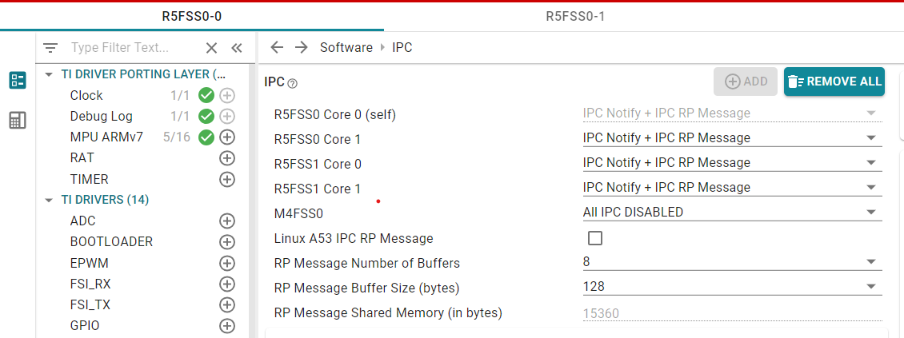
Enable IPC between current CPU and another CPU
Keep IPC disabled with a CPU if not needed
Check this to enable IPC with Linux
26

Slide 27
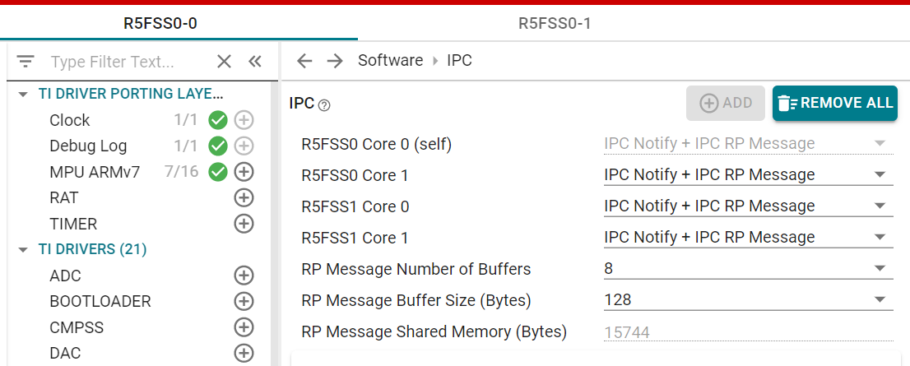
Enable IPC between current CPU and another CPU
27

Slide 28
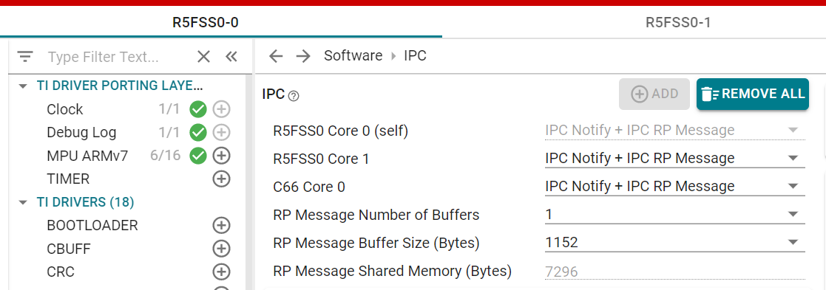
Enable IPC between current CPU and another CPU
28

Slide 29

Boot flow
ROM BOOT
SBL BOOT
POWER-ON
ROM Bootloader (RBL)
Secondary Bootloader (SBL)
Application Binary
29

Slide 30
SBL Boot flow
RPRC 1
…….
…….
RPRC N
SBL Parse
MULTICORE APPIMAGE
For each RPRC
Initialize Core
Load RPRC Image
Set Entry Point
Release Core from Reset
RPRCs for N CPUs were found in the multicore appimage
30

Slide 31
Application Layer
cdc_echo example
Tiny USB
CDC-ACM Class
USB Device Core
FreeRTOS / NORTOS Services
TinyUSB Porting Layer (DCD)
Device Driver
USB Device Core Driver
SoC Porting Layer
SOC Specific USB Controller Hardware

Slide 32
Application
Layer 7 - Application
EtherNet/IP Adapter Stack
Customer
lwIP Stack
ARM
Processor
TI / Third Party
TI
EtherNet/IP Adapter FWHAL
ICSS-EMAC
PRUICSS Driver
PRU Firmware
PRUICSS
PRUICSS with 2x MII/RGMII
Layer 2 - Data Link
Layer 1 - Physical
Ethernet PHY
Ethernet PHY

Slide 33
ARM
PTP Driver+Stack/DLR Driver
TCP/IP Stack
Yes
No
If PTP/DLR ?
L3 RAM
Priority Queue 0
Priority Queue 1
Priority Queue 2
Priority Queue 3
33

Slide 34
Application
Layer 7 - Application
Profinet Device Stack
Customer
lwIP Stack (including SNMP)
ARM
Processor
TI / Third Party
TI
Profinet Device FWHAL
ICSS-EMAC
PRUICSS Driver
PRU Firmware
PRUICSS
PRUICSS with 2x MII/RGMII
Layer 2 - Data Link
Layer 1 - Physical
Ethernet PHY
Ethernet PHY

Slide 35
Application
Layer 7 - Application
lwIP Stack (including SNMP)
ARM
Processor
PRP FWHAL
ICSS-EMAC
PRUICSS Driver
PRU Firmware
PRUICSS
PRUICSS with 2x MII/RGMII
Layer 2 - Data Link
Layer 1 - Physical
Ethernet PHY
Ethernet PHY

Slide 36
ARM
Profinet Stack
lwIP Stack
MSRAM
Priority Queue 0
Priority Queue 1
Priority Queue 2
Priority Queue 3
LLDP, MRP, PTCP
RTA, DCP
VLAN Priority
4-7
VLAN Priority
0-3
36

Slide 37
HOST
Queue 3
Queue 4
Queue 1
Queue 2
Collision Queue
PORT 0
PORT 1
Queue 3
Queue 4
Queue 3
Queue 4
Queue 1
Queue 2
Collision Queue
Queue 1
Queue 2
Collision Queue

Slide 38
ICSS EMAC RX/TX Data Path
MII/RGMII picks up the data and copies it to L2 FIFO and sends a signal to firmware
Firmware copies the data to queue buffers (MSRAM) and signals host through an interrupt
Host services the interrupt and copies the data from MSRAM to application buffers
RX
Application creates the packet
Host copies the data to queue buffers (MSRAM) from application buffers and signals PRU to pick it up
Firmware picks up the data and puts it in Tx FIFO
MII/RGMII picks up the data and sends it on the wire
TX

Slide 39
ICSS EMAC Storm Prevention Architecture
Broadcast/
Multicast Packet Received
On PRU
On ARM
Drop Packet
Check Credit Value
Storm Prevention Credits
Credits = 0
Credit Value > 0
Decrement Credits
Reset value with default
Allow packet to pass
39

Slide 40



ROUTER with
DHCP SERVER
192.168.1.1
EVM
192.168.1.100
HOST PC
192.168.1.101
40

Slide 41
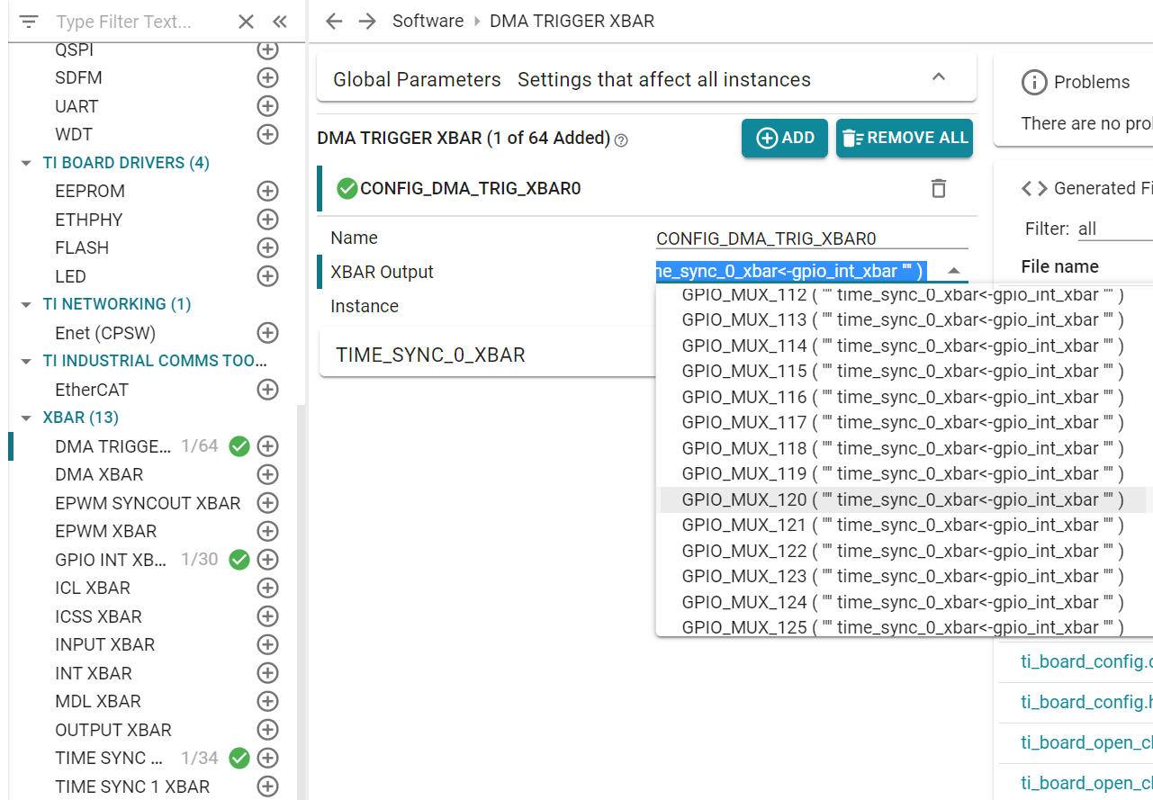
41

Slide 42
AM263 - ADC Multiple SOC EPWM Example
SOC0
RESULT0
ADC 2
SOC1
RESULT1
SOC2
RESULT2
EPWM 0
SOC A
SOC0
RESULT0
ADC 1
SOC1
RESULT1
SOC2
RESULT2
42

Slide 43
AM263 - ADC Burst Mode Oversampling Example
SOC0
RESULT0
ADC 2
SOC1
RESULT1
EPWM 0
SOC A
SOC12
Burst mode enabled
SOC13
SOC14
RESULT2
SOC15
43

Slide 44
AM263 - ADC SOC Continuous DMA Example
ADC 2
SOC0
RESULT0
DMA Channel 0
RESULT BUFFER0
EPWM 0
SOC A
ADC 1
SOC0
RESULT0
DMA Channel 1
RESULT BUFFER1
44

Slide 45
AM263 – DAC DMA Sine wave Example
DMA Trigger
RTI1
EDMA
DAC
Sine wave output
EDMA Destination
Sine Table
(Buffer with sine values)
EDMA Source
45

Slide 46
EPWM
EDMA
Time Base
SOCA
DMA XBar
DMA Trigger XBar
Configuration Array
Counter Compare
Data transfer to EPWM registers
46

Slide 47
CTRIPH
EPWM
PWM_B
PWM output signal
CMPSSA
TRIP4
Input signal to CMPSS
CMPINxP
CTRIPOUTH
OUTPUT XBAR
XBAROUT
Trip output signal
CMPIN1P exceeds internal DAC output
Internal DAC output
CMPSS input signal
PWM output signal
PWM tripped
t
t
47

Slide 48
EPWM0
ADC EVT
OST TRIP Input
PWM output signal
Ramp Waveform
ADC
EPWM1
DAC
ADC EVT
CBC TRIP Input
PWM output signal
PPB
EPWM2
ADC EVT
Direct TRIP Input
PWM output signal
ADC Input exceeds PPB High limit
DAC Output signal
(ADC Input)
PPB High level
PPB Low level
PWM tripped
t
PWM output signal
t
48

Slide 49
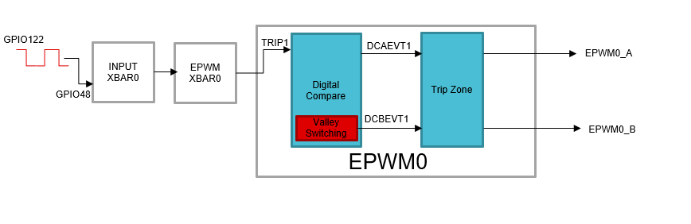
49

Slide 50
CMPAHR(8)
CMPBHR(8)
HRPWM Micro-edge Positioner (MEP) Calibration Module
HRCNFG
TBPRDHR(8)
HRMSTEP
EPWM(0-4)
EPMWA
ePWMxA
EPMWB
ePWMxB
50

Slide 51
SCICLIENT OPERATION
APPLICATION
Any system control request – resource, power, clock, security
Sciclient sends a TISCI message to the SYSFW/HSM Runtime with the specifics of the request, on a secure proxy thread allotted for this particular core.
SECURE PROXY THREAD
SYSFW/HSM Runtime
SCICLIENT
SYSFW sends back a response after processing the request
51

Slide 52
SCICLIENT
RESOURCE MANAGEMENT
POWER MANAGEMENT
SECURITY
FIREWALLS
PROCESSOR BOOT
52

Slide 53
SYSFW-HS-FS
TI MEK
SYSFW-HS-FS-ENC
TI MPK
SYSFW-HS-FS-ENC-CERT
Unsigned, unencrypted SYSFW for HS-FS device
Encrypted SYSFW for HS-FS device
X509 Certificate for the Encrypted SYSFW for HS-FS device
(sysfw-hs-fs-enc.bin)
(sysfw-hs-fs-enc-cert.bin)
SYSFW
Unsigned, unencrypted SYSFW for GP device
(sysfw.bin)
53

Slide 54
x509 Certificate
X509 Certificate
SBL image
SBL image
SYSFW
Board Config
54

Slide 55
Device Type | Validation Requirements for SBL |  |  | Validation Requirements for HSMRt/SYSFW
 | Certificate Verification | Image Integrity Protection | Image Decryption | Certificate Verification | Image Integrity Protection | Image Decryption
HS-FS | Not Performed | Optional | Not Performed | Required | Required | Optional
HS-SE | Required | Required | Optional | Required | Required | Optional
GP | Not Performed | Optional | Not Performed | Not Performed (N/A in case of HSMRt) | Not Performed (N/A in case of HSMRt) | Not Performed (N/A in case of HSMRt)
55

Slide 56
Target EVM
(Running SBL PCIE)
Target EVM
(Running SBL PCIE HOST)
Initialization and link training will happen with ROM if target boots in PCIe boot mode. Else link training happens with SBL PCIE
Skipped if booting in PCIe boot mode. Use ROM configuration for PCIe instead
Initialize PCIe
Initialize PCIe
Configure ATU for receiving appimage
Transfer SBL PCIe image
Happens only if target EVM is booting in PCIe boot mode.
Notify host application ready to receive appimage
Wait for notification from target EVM
Transfer application image
Authenticate and boot application on receiving the “MAGIC WORD”
Notify target EVM offset to which image is send
Mark image transfer completion with “MAGIC WORD”

Slide 57
Optiflash images

Slide 58
am263x_hardware_arch
AM263x MCU
SRAM
SRAM
CPU 0
SRAM
SRAM
QSPI FLASH
CONTROLLER
INTERCONNECT
CPU 1
External Flash

Slide 59
OpTI-Flash
SW Tool
Smart Placement
OpTI-Share
Hardware
FLC- Fast Local Copy
SDK Drivers
OTFA – On The Fly Authentication
RAT – Region Access Translation
RL2 – Remote L2 Cache
FOTA
Overlay Manager
Flash Controller (OSPI)

Slide 60
AM2x MCU
With OpTI-Flash
SRAM
SRAM
CPU 0
RAT
FLC
SRAM
SRAM
RL2
FSS
OTFA
ECC
OSPI FLASH
CONTROLLER
INTERCONNECT
CPU 1
RAT
FLC
FOTA
RL2
External Flash

Slide 61
xip_flc_boot_process
HW Init
(XTAL, SoC,..)
ROM Boot Loader
(RBL)
Secondary Boot Loader (SBL)
Application Init
With OPTI-FLASH
Application

Slide 62
Application Init
HW Init
(XTAL, SoC,..)
ROM Boot Loader
(RBL)
Secondary Boot Loader (SBL)
Application
Application image download
(Time proportional to image size)

Slide 63
optishare_offline
CPU 1 Binary
CPU 1 Binary Without Shared RO + Text
CPU 2 Binary
OpTI-Share
CPU 2 Binary Without Shared RO + Text
CPU 3 Binary
CPU 2 Binary Without Shared RO + Text
CPU 4 Binary
CPU 2 Binary Without Shared RO + Text
Shared Object

Slide 64
optiflash_rat_safe_sec_perf
AM2x MCU
With OpTI-Flash
SRAM
SRAM
CPU 0
RAT
FLC
SRAM
SRAM
RL2
FSS
OTFA
ECC
OSPI FLASH
CONTROLLER
INTERCONNECT
CPU 1
RAT
FLC
FOTA
RL2
External Flash

Slide 65
optishare_online
CPU1
CPU2
Real time Address
Translate (RAT)
Real-time Address
Translate (RAT)
Inter connect
RAM
CPU1 Binary
(without common code/data)
RW data (CPU1)
Shared code, RO data
CPU2 Binary
(without common code/data)
RW data (CPU2)

Slide 66
optiflash_fota_rat_safe_sec_perf
AM2x MCU
With OpTI-Flash
SRAM
SRAM
CPU 0
RAT
FLC
SRAM
SRAM
RL2
FSS
OTFA
ECC
OSPI FLASH
CONTROLLER
INTERCONNECT
CPU 1
RAT
FLC
FOTA
RL2
External Flash

Slide 67
function_memory_ordering
int main()
{
init();
while (1)
{
….
}
}
void init()
{
ClockInit();
TimerInit();
}
The linker will order input sections based on call graph function preorder using metainfo.
main | 0
TimerInit
ClockInit
Init | 200
main | 0
Init
ClockInit
TimerInit
 | 200

